Slide 1

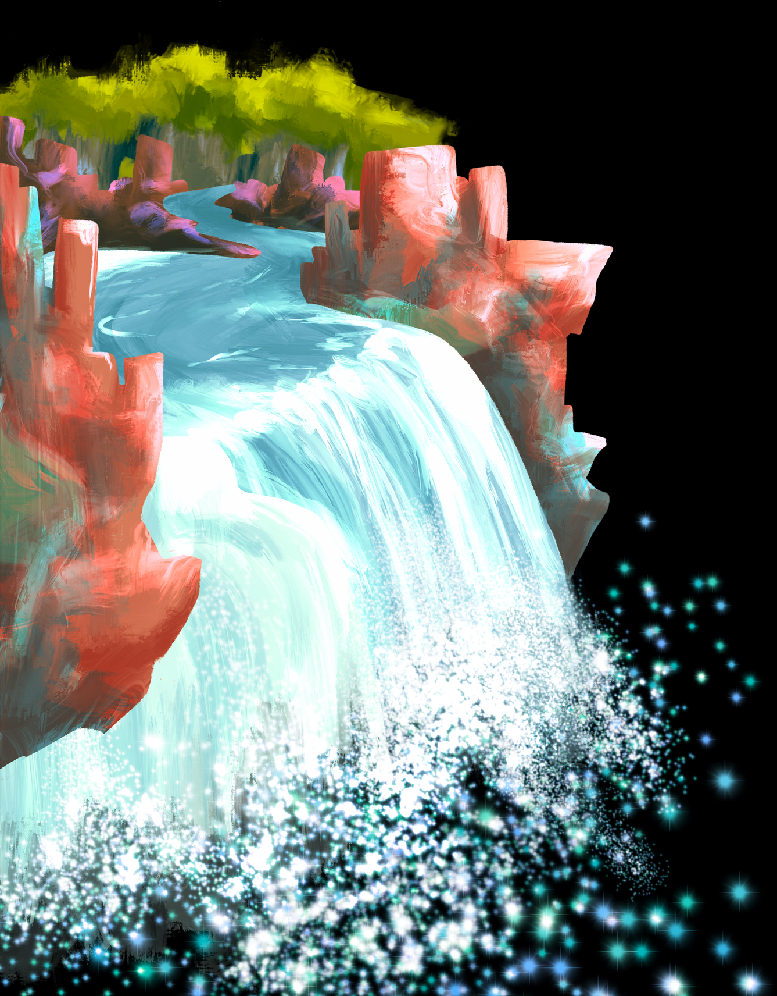
Descriptive Text
By : Nurila Apriliani, S.Pd

Slide 2


WHAT ARE COVERED IN DESCRIPTIVE TEXT?
Definition
Purpose
Generic Structure
Language Features
Example
Examples of TKA Test Questions

Slide 3


Descriptive Texts are texts which describe a person, a thing, or a place. It presents information about what a person or a thing is like.
The Purpose of descriptive text is to describe and reveal a particular person, place or thing in detail.

Slide 4
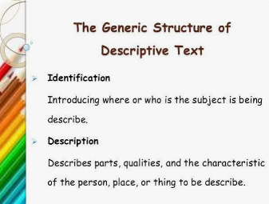

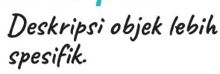




Slide 5
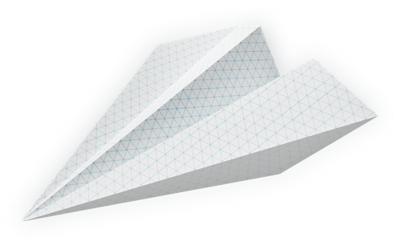
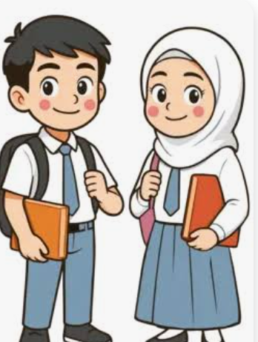
Language Features
Specific participant has certain object, is not common and unique (only one). For example: Beach, My house, Borobudur Temple, Lombok Island, etc.
The use adjective : to clarify the noun, for example a beautiful beach, a handsome man, the famous place in Jepara, etc
Simple present tense: the sentence pattern used is simple present because it tells the fact of the object described
Action verb : verbs that show an activity (for example: run, sleep, walk, cut, etc

Slide 6
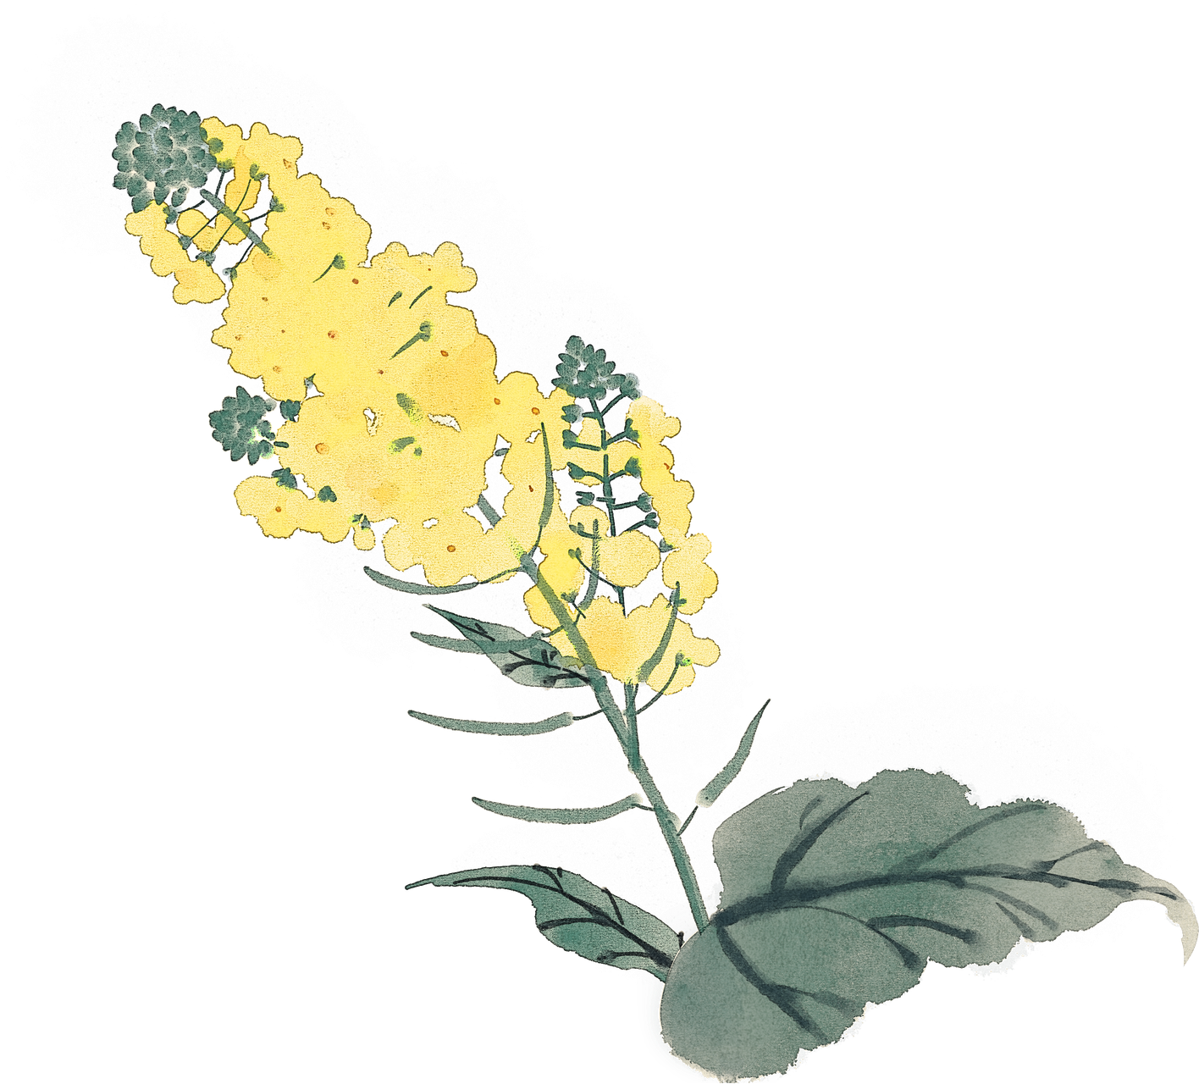
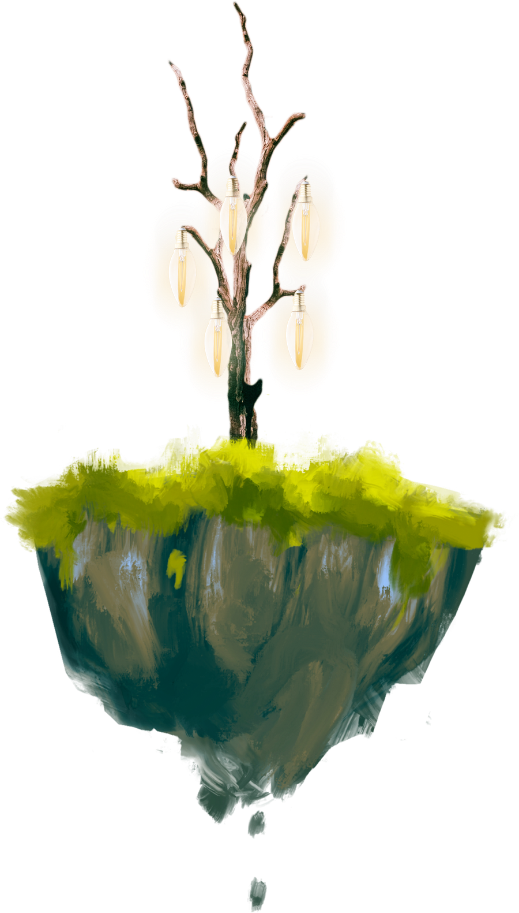
Examples
My Best Friend, Hanni
Description:
Hanni is so pretty. She has an oval face, rounded eyes, pointed nose, and beautiful black long hair. Her skin color is fair. Also, she has a slim body and is quite tall. She is 155 centimeters tall.
Hanni really loves to sing and dance. She joins the dance club as her extracurricular activity at school. She is smart and friendly. She often helps me to do my homework and always respects the elders. Everyone loves her.
Identification:
Let me introduce you to my best friend. Her Name is Hanni. She is my classmate in Junior High School. She is thirteen years old.

Slide 7
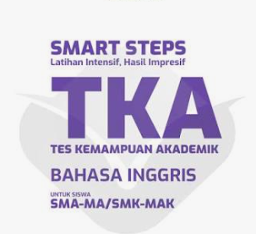
The Great Barrier Reef
The Great Barrier Reef is one of the most beautiful places in the world. It is located in the Pacific Ocean, near the northeast coast of Australia. The reef is very big. It stretches over 2,000 kilometers and can even be seen from space. There are many small coral islands and clear, warm waters around the reef.
This reef is full of life. There are many kinds of colorful fish, sea turtles, dolphins, and even sharks. Coral of different shapes and colors grows under the water. Sea birds fly over the reef and nest on small islands. People can see this beauty by swimming, diving, or joining a boat tour.
The colors under the water are amazing. Coral comes in red, yellow, green, and blue. Some coral looks like trees, and some looks like big round stones. Small fish swim in and out of the coral like they are playing a game. In some places, soft coral moves with the water like grass in the wind. When the sun shines, the reef looks bright and full of light. It feels like a different world under the sea.
The reef is not only beautiful, but also very important. It helps protect the coast from big waves and storms. It is a home for sea animals and a place where plants can grow. Many people also get food and jobs from the sea near the reef. Without the reef, the ocean would not be the same.
Adapted from: https://www.britannica.com/place/Great-Barrier-Reef

Slide 8
Which parts of the text best support the idea that the Great Barrier Reef is both beautiful and important?
There is more than one correct answer. Click on every correct answer!
A. The reef helps protect the coast from big waves
B. It is home to sea turtles, dolphins, and colorful fish
C. The coral reefs grow best in cold, deep water
D. Some areas of the reef are damaged by starfish and warm water
E. The reef was discovered by sailors in the 1800s
Which of the following descriptions are mentioned clearly in the text?
A. The reef was built by local communities over hundreds of years
B. The reef is located in the Pacific Ocean near Australia
C. The reef can help protect the coast from big waves
D. The reef is home to sea turtles and dolphins
E. The reef has more than 10,000 coral islands
Which of the following best represents the main idea implied by the text?
A. The reef is useful for fishing and shipping
B. The reef is large, but not important to people
C. The reef is a natural treasure that must be cared for
D. The reef is only for scientists and researchers to explore
E. The reef is a protected area that should be closed to visitors

Slide 9
Ice breaking

Slide 10
Thankyou

