Slide 1
Start with prayer

Slide 2



Online Meeting:
MGMP Bahasa Inggris SMA
Aceh Timur 2026
Genre Pedagogy
Zahratul Riza, S.Pd.I., M.Pd
English Teacher at SMAN 1 Idi Rayeuk

Slide 3
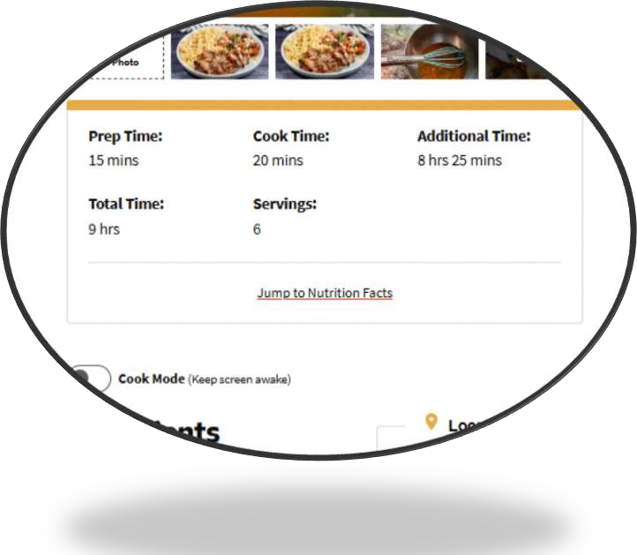
Guess the genre from the incomplete picture!
1.
recipe

Slide 4

2.
weather forecast

Slide 5
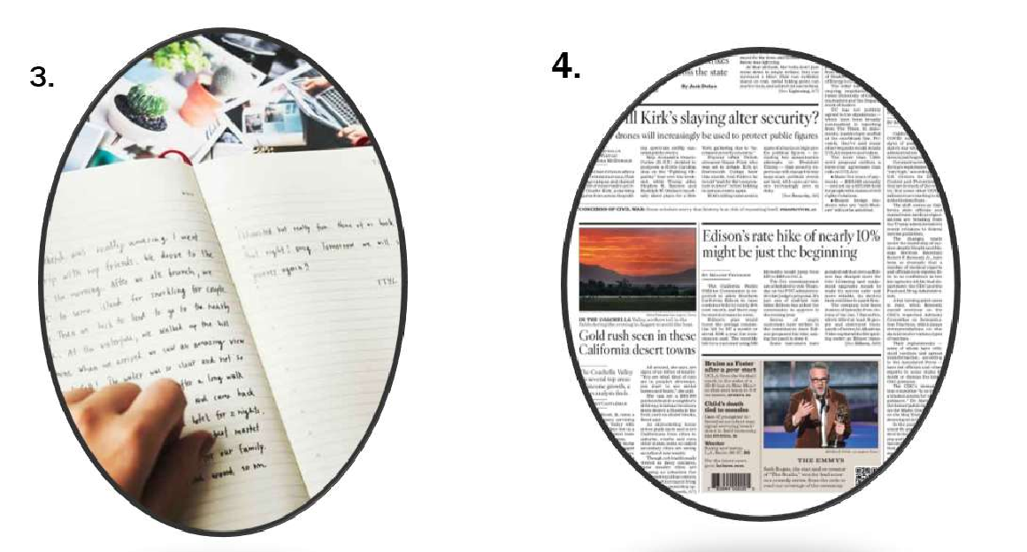
diary
newspaper

Slide 6

5.
Job advertisement

Slide 7
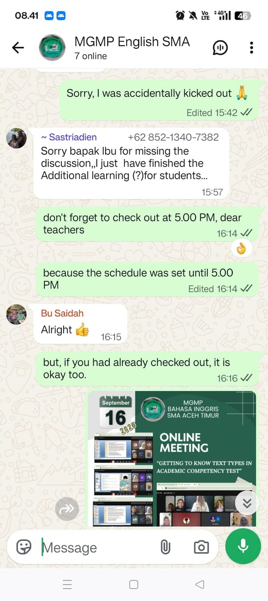
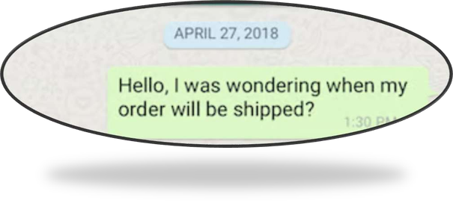
6.
text message

Slide 8
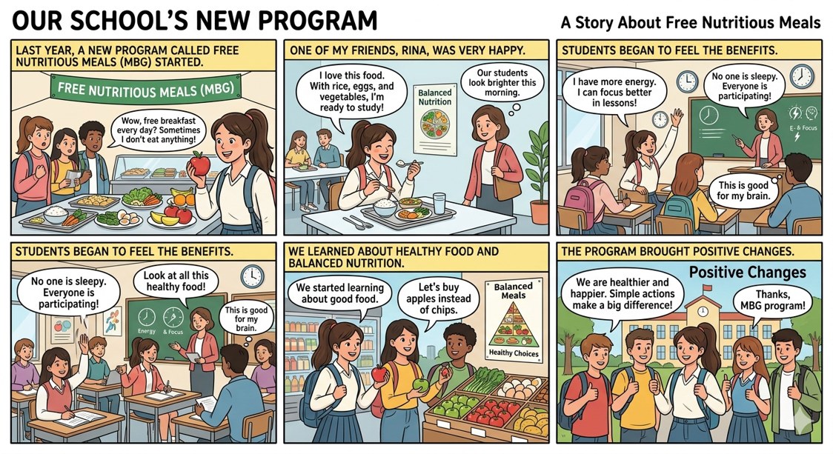
7.
comic strip

Slide 9

8.
travel brochure

Slide 10
Answers
1. recipe
2. weather forecast
3. diary
4. newspaper
5. job advertisement
6. text message
7. comic strip
8. travel brochure

Slide 11


How did you know?
Would everyone recognize these kind of writing?

Slide 12
Genre
A genre is a type of spoken or written or multimodal text. We recognize it as a type (or category), because the various examples of it (such spoken or written texts) share similar purpose, content, form, and/or context. (Hyon, 2018)

Slide 13

Wedding invitation

Slide 14
Genres & Text Types
GENRES
TEXT TYPES
• • • • • •
Application letter Research paper Advertisement Instruction manual Recipe Political speech
• • • • • •
Explanation
Narrative
Exposition
Report
Procedure(Instruction)
Recount
Many people use
genre
to refer to both
categories of texts.

Slide 15

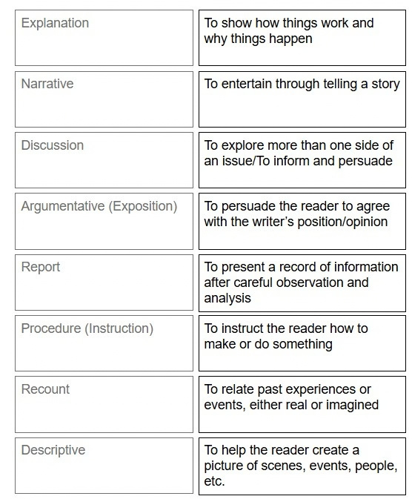
Text Type
The way the text is organized linguistically (structure and language patterns).

Slide 16
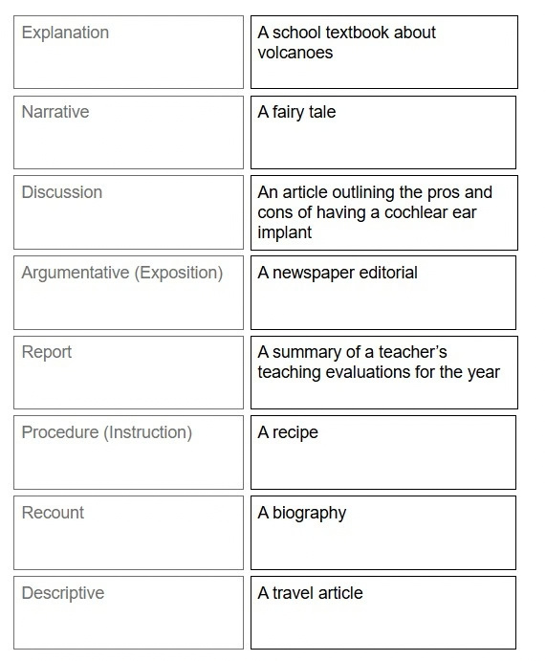
Text Types and Examples
genres

Slide 17
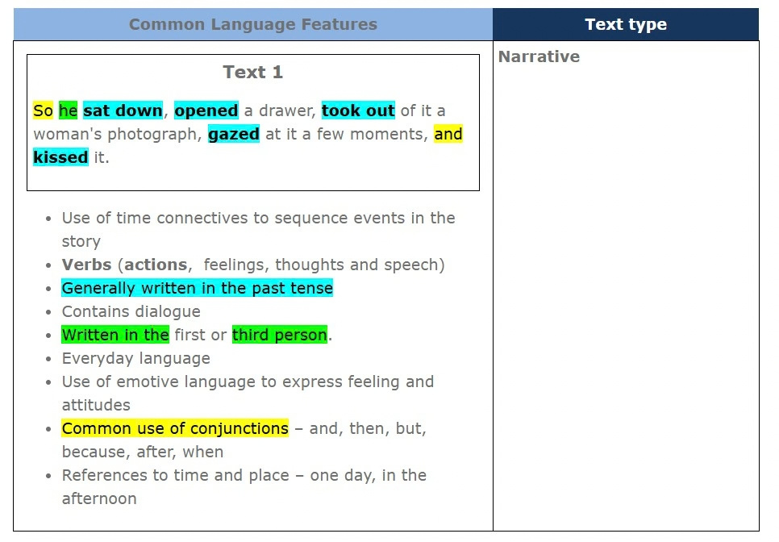
Text Types and Common Language Features

Slide 18
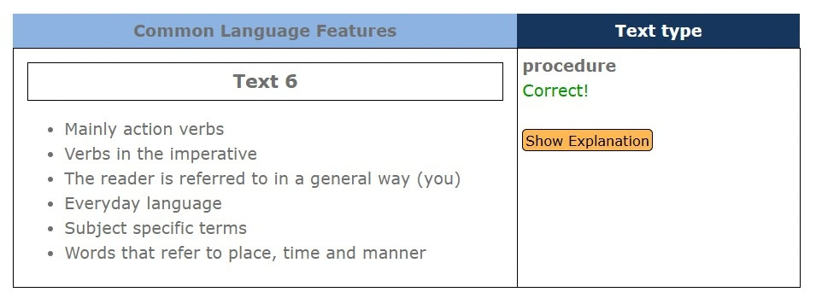
Procedure Text Type

Slide 19
Summary of Text Types in G10-12 textbooks
Grade 10
Grade 11
Grade 12
description
description
Exposition
(argumentation) discussion
recount
expository
procedure
narrative
exposition (argumentation)
procedure
narrative(legend, fairy
narrative
tale, fantasy

Slide 20

Infographic: genre or text type?
A multimodal format that blends different genres and text types
Genre: Report
Text Types:
-description
-explanation

Slide 21




Difficult to classify multimodal formats

Slide 22
Genre Teaching in Writing: Using AI
“My students are[Gradex,,CEFR Xlevel].They need to write a [text
type] paragraph on [topic]. They need to write at least [number of] sentences.”
1. Create a paragraph frame
2.Create a word bank with [number of] words (4-6) 3.Create a model paragraph
4. Create an assessment checklist with [number of] criteria
5.
Create a lesson plan based on the genre approach

Slide 23
Trying it out! Paste the responses from ChatGPT!
Group 1
2
3
4
5
Text Type
procedure
narrative
recount
description
argumentation
Topic
How sports keep us healthy
A ghost story
Sports events I went to
My favorite famous athlete
The necessity of digital etiquette

Slide 24

Reflection
How confident were you about teaching genres/text types before our meeting?

Slide 25
Reflection
How confident are you about teaching genres/text types now?

