Slide 1
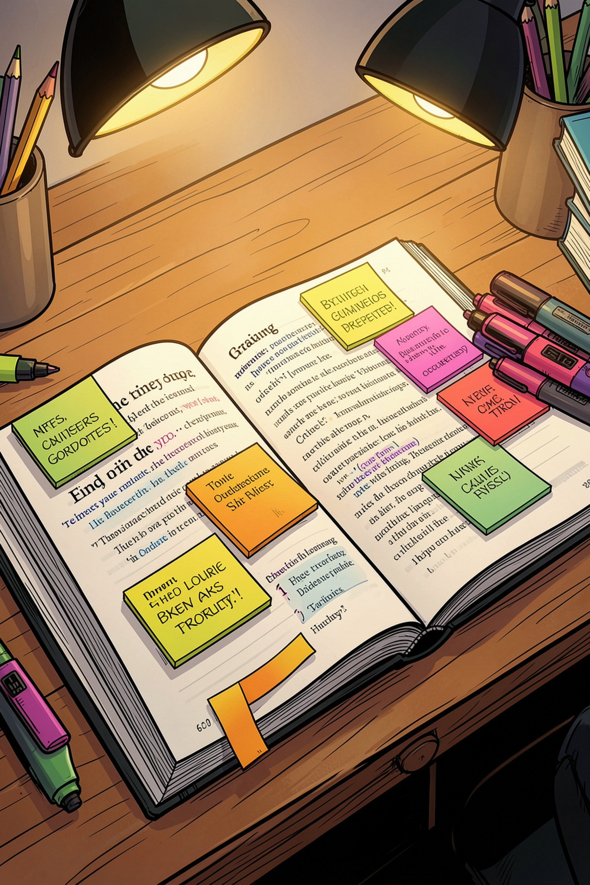

Types of Texts in English
A comprehensive guide to the five major text types found in TKA questions — Descriptive, Recount, Narrative, Procedure, and Exposition.
Presentation Content for MGMP Bahasa Inggris Aceh Timur
Wednesday, 16 September 2026
Presented by:
Nurlina, S.Pd.I., M.Pd. (Miss Lina)
The English Teacher at SMA Negeri 1 Darul Ihsan
Aceh Timur

Slide 2

TEXT TYPE A
Descriptive Text
Purpose
Presents detailed, objective information about an object, person, event, or place so the reader can easily visualize it.
Structure
Identification — Introduces the object and its recognizable features
Description — Detailed characteristics: appearance, qualities, functions
Characteristics
Simple present tense
Adjectives (beautiful, tall, amazing)
Figurative language: metaphors, similes (e.g., as white as snow)

Slide 3




TEXT TYPE B
Recount Text
Orientation
Introduces the 5W1H: What, Where, When, Who, Why, How
Events
Chronological account of events, divided into key paragraphs
Reorientation
Optional closing: conclusion, feelings, or lessons learned
Uses simple past tense, time connectives (after that, then, finally), action verbs, and is based on facts or personal experiences.

Slide 4
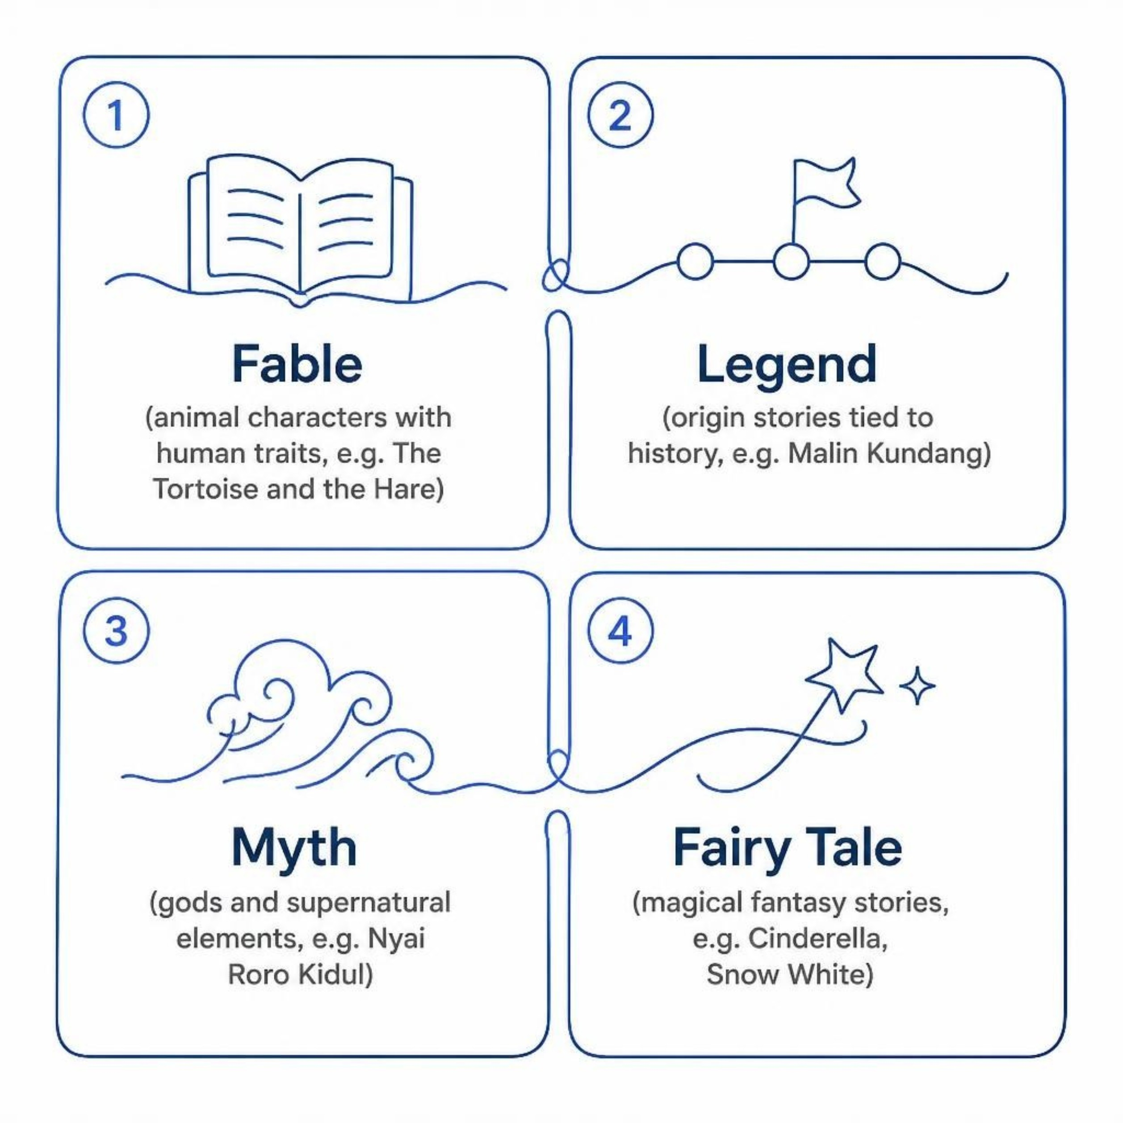
TEXT TYPE C
Narrative Text
Purpose
Tells a fictional story (folktale, fairy tale, legend, myth, fable, short story) to entertain and teach moral values.
Structure
Orientation — Characters, setting, time
Complication — Conflict faced by the main character
Resolution — Problem solved; happy or tragic ending
Reorientation (Optional) — Moral lesson or epilogue

Slide 5

TEXT TYPE D
Procedure Text
Explains step-by-step stages to achieve a goal — helping readers avoid mistakes and complete tasks successfully.
Materials
List tools and ingredients needed for the procedure.
Title
Steps
State the goal clearly, e.g. How to Make Coffee.
Give numbered imperatives in sequence to complete task.
Uses simple present tense, imperative sentences (put, cut, heat, stir), sequence connectors (first, next, then, finally), and adverbs (slowly, carefully).

Slide 6
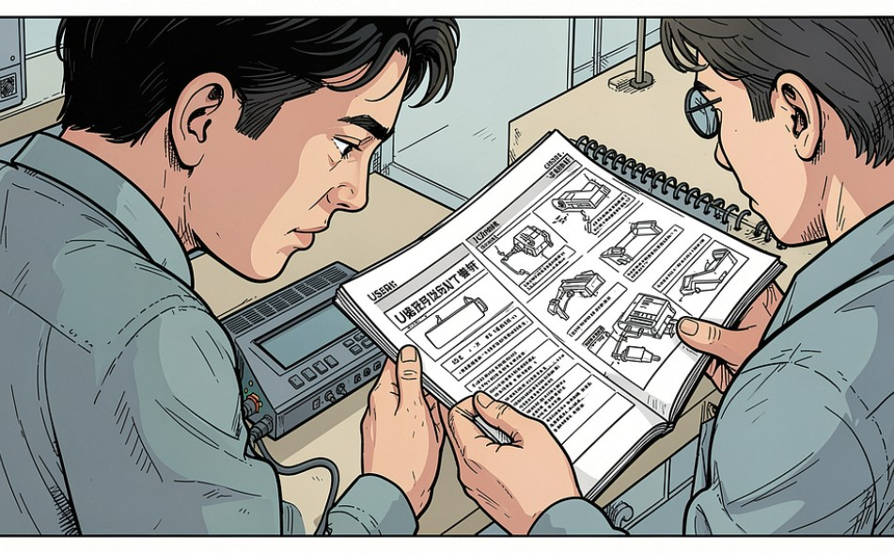
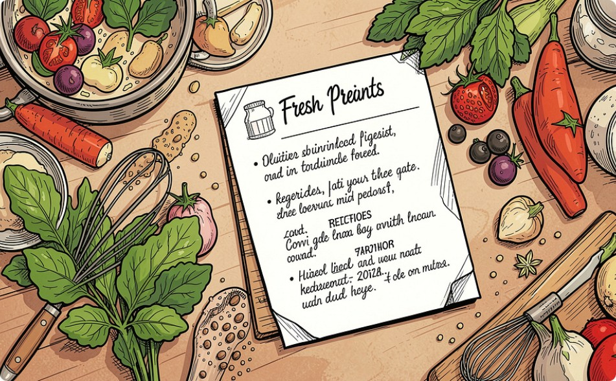
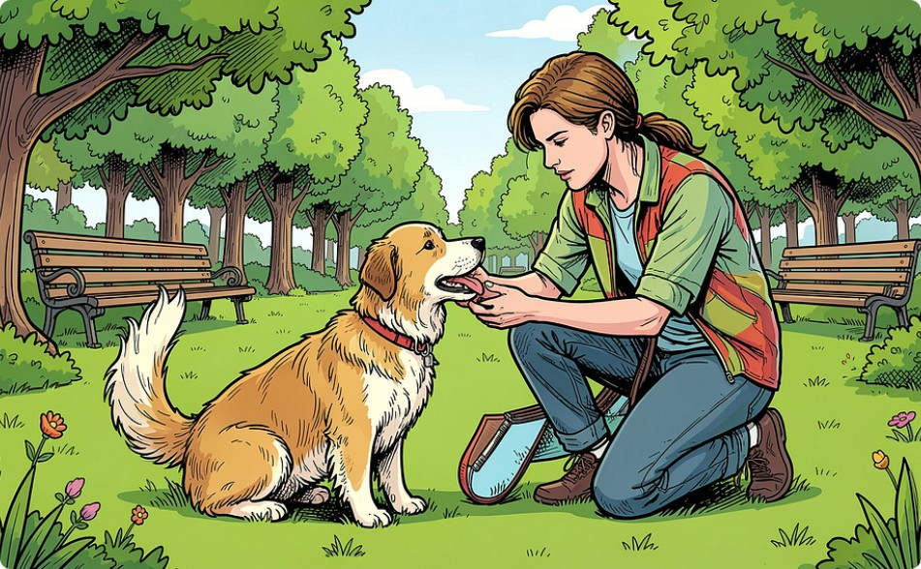
TEXT TYPE D — VARIANTS
Types of Procedure Texts
Manuals / Instructions
Recipes
How to Do Something
Explain how to use something.
Example: How to Use the Coffee-Brew-Machine 3000™
Provide instructions to prepare food or beverages.
Example: How to Make Coffee Pudding
Explain how to carry out a particular activity.
Example: How to Train Your Pet

Slide 7
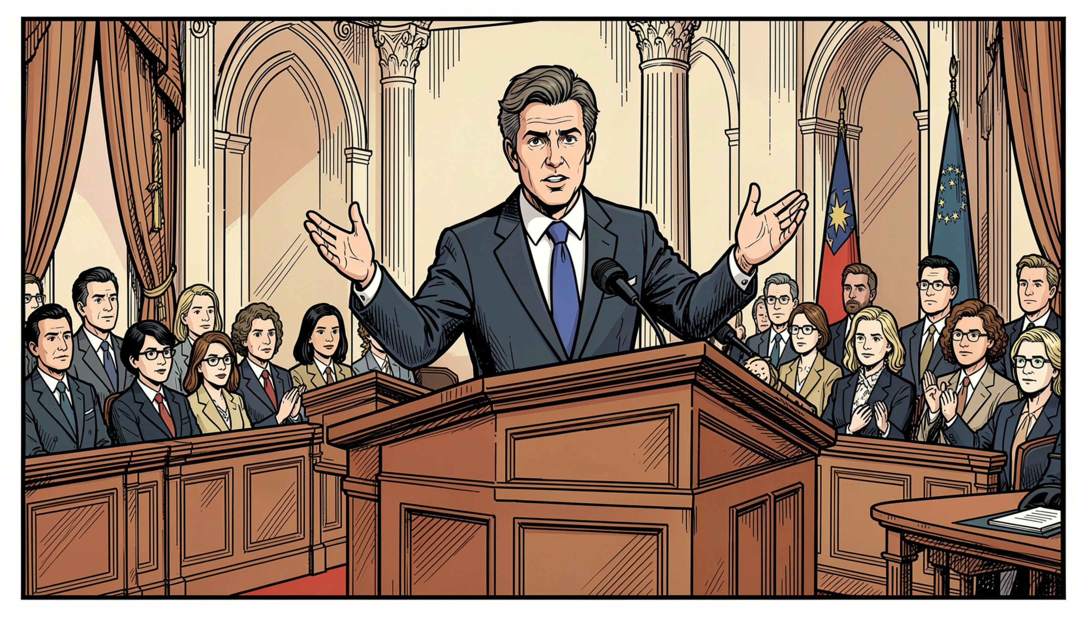
TEXT TYPE E
Exposition Text
Purpose
Supports the writer's opinion through logical, systematic arguments to persuade the reader using facts and opinions.
Structure
Thesis — States the issue and the writer's position
Arguments — Logically organized reasons, facts, and examples
Restatement (Analytical) or Recommendation (Hortatory)

Slide 8
TEXT TYPE E — COMPARISON
Analytical vs. Hortatory Exposition
Analytical Exposition
Hortatory Exposition
States and supports an opinion through arguments.
Persuades and gives recommendations to the reader.
Structure: Thesis → Arguments → Restatement
Example: The Importance of Conserving Energy
Structure: Thesis → Arguments → Recommendation
Example: Reasons Why We Should Conserve Energy
Both use simple present tense, logical connectives (because, therefore), mental verbs (think, believe, argue), and modals (should, must, have to).

Slide 9
Text Types at a Glance
Type | Purpose | Tense | Key Features | Example
Descriptive | Describe an object/person/place | Simple Present | Adjectives, figurative language | My Beautiful School
Recount | Retell past events | Simple Past | Time connectives, action verbs | My Holiday Trip
Narrative | Entertain & teach morals | Simple Past | Complication, resolution | Cinderella
Procedure | Explain steps to do/make | Simple Present | Imperatives, sequence words | How to Make Coffee
Exposition | Persuade with arguments | Simple Present | Thesis, arguments, modals | Save Energy

Slide 10


Key Takeaways
Identify the Purpose
Each text type serves a distinct goal — describe, recount, narrate, instruct, or persuade.
Check the Tense
Present tense for Descriptive, Procedure, Exposition; Past tense for Recount and Narrative.
Recognize Structure
Every text type follows a predictable structure — knowing it helps you answer TKA questions faster.
Spot Language Features
Imperatives signal Procedure; modals signal Exposition; time connectives signal Recount or Narrative.

Slide 11
Thank you

