Slide 1
BEDAH SOAL TKA BAHASA INGGRIS
Sesi Kolaborasi & Modifikasi Pengajaran
Forum MGMP Tingkat SMA - 2026
Erlinawati, S.Pd & Cut Nazariah, S.Pd.I

Slide 2
Kesepakatan
  Be On time
  Be active and participative
  Respect each other
  ???

Slide 3
Ice Breaking - "The Distractor Trap"
What is the most accurate conclusion we can draw from this text?
Every morning before entering the twelfth-grade classroom, Mr. Budi always brews a cup of black coffee without sugar. However, today, he added two spoons of sugar to his coffee because he stayed up all night grading the tryout exams.
He is simply exhausted and needs a desperate sugar rush to survive the day.
The sugar is actually salt, and Mr. Budi’s morning is about to get much, much worse.
C. Mr. Budi is secretly planning to open a coffee
shop if the students fail the try out.
D. The try out scores are so bitter, he needs
something sweet to heal his soul.
E. Mr. Budi is so sleep-deprived that he actually
believes adding two spoons of sugar to his coffee
will automatically add two extra points to every
student's try out score.

Slide 4
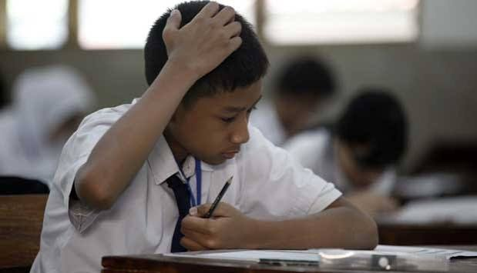
Introduction
Bayangkan siswa kita menghadapi teks Analytical Exposition yang rumit dan sangat panjang...
Waktu tersisa tinggal 2 menit.
Apa respons spontan mereka?
  Langsung panik dan nge-blank
  Strategi "tebak kancing" (asal pilih)
  Menyerah sebelum membaca
Today’s Goal
Merumuskan dan menyepakati strategi kilat agar siswa memiliki ‘trik’ saat menghadapi TKA

Slide 5
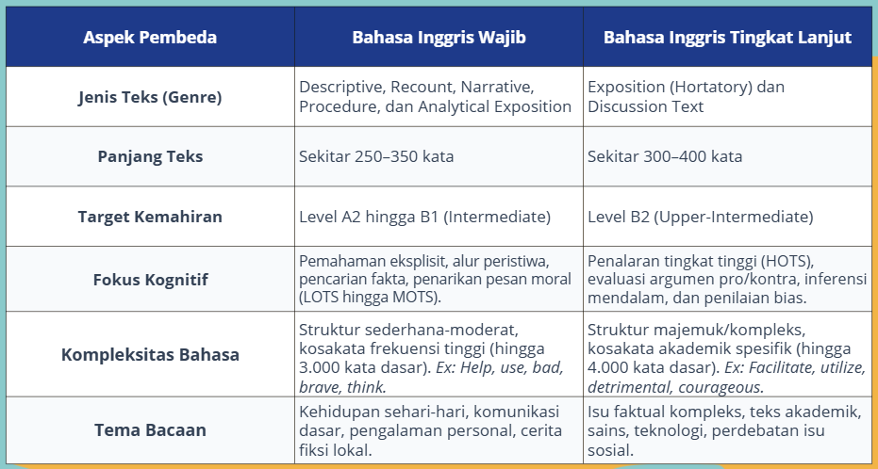
Asesmen TKA 2026 (BSKAP 045/H/AN/2025)

Slide 6
3 Level Kognitif Soal TKA
1. Tekstual (Eksplisit)
2. Inferensial (Tersirat)
Menemukan fakta, detail informasi yang tertulis langsung di dalam teks. Sangat mengandalkan teknik membaca scanning & skimming.
3. Evaluasi & Apresiasi
Menarik kesimpulan logis dari bacaan / Menyimpulkan informasi tersirat
Membuat penilaian terhadap ide, Menilai keberpihakan (bias) penulis, Mengevaluasi kelogisan argumen dan keakuratan informasi

Slide 7
EXAMPLE (NARRATIVE TEXT)
The Lion and the Mouse
Once upon a time, in a thick jungle in Africa, there lived a strong and fierce lion. Every afternoon, the lion would rest under the cool shade of a big tree after walking through the forest.
One day, while he was sleeping, a playful little mouse passed by. The mouse saw the lion’s thick mane and was curious. He climbed up and began to jump around on the lion’s head, playing in his mane.
The lion woke up suddenly and was not happy at all. He quickly caught the mouse in his big paw and roared, “Who dares to wake me up?”. He was very angry and almost killed the mouse.
Scared and shaking, the mouse begged the lion, “Please don’t kill me! I didn’t mean to bother you. If you let me go, I promise I’ll help you one day”.
The lion laughed loudly. “You? Help me? That’s funny”. But the lion was feeling kind, so he let the mouse go free.
A few days later, the lion was walking through the jungle again when he fell into a trap. A net set by hunters caught him, and he couldn’t escape. He tried to bite and tear the ropes, but they were too strong. The lion roared loudly, hoping someone would come.
The mouse heard the roar and ran to help. He saw the lion trapped and quickly started to chew the ropes with his sharp teeth. After some time, the net broke, and the lion was free.
The lion looked at the mouse with surprise and said, “Thank you! You really saved my life “.
The mouse smiled and said, “I told you I would help you one day”.
From that moment on, the lion and the mouse became close friends. The lion learned that even small creatures can do great things, and we all need help sometimes.
1. Which option best summarizes the story?
a. Beginning: A lion was walking through the jungle.
Problem: The mouse got lost and couldn’t find food.
Solution: The lion gave food to the mouse.
Lesson: Always be generous to those in need.
b. Beginning: A mouse accidentally disturbed a sleeping lion.
Problem: The lion was caught in a hunter’s net.
Solution: The mouse chewed through the net and set the lion free.
Lesson: Even the smallest creature can be a great help.
c. Beginning: The lion and mouse were best friends.
Problem: The lion got hurt in a fight.
Solution: The mouse helped him find water.
Lesson: Friendship is built on adventure.
d. Beginning: A mouse was building a home near a tree.
Problem: A storm destroyed the tree and trapped the lion.
Solution: The mouse called for help from the jungle.
Lesson: Team work solves big problems.
e. Beginning: A lion was hungry and searching for food.
Problem: He couldn’t catch any prey.
Solution: The mouse helped him find food.
Lesson: Hunger teaches humility.

Slide 8
The Lion and the Mouse
Once upon a time, in a thick jungle in Africa, there lived a strong and fierce lion. Every afternoon, the lion would rest under the cool shade of a big tree after walking through the forest.
One day, while he was sleeping, a playful little mouse passed by. The mouse saw the lion’s thick mane and was curious. He climbed up and began to jump around on the lion’s head, playing in his mane.
The lion woke up suddenly and was not happy at all. He quickly caught the mouse in his big paw and roared, “Who dares to wake me up?”. He was very angry and almost killed the mouse.
Scared and shaking, the mouse begged the lion, “Please don’t kill me! I didn’t mean to bother you. If you let me go, I promise I’ll help you one day”.
The lion laughed loudly. “You? Help me? That’s funny”. But the lion was feeling kind, so he let the mouse go free.
A few days later, the lion was walking through the jungle again when he fell into a trap. A net set by hunters caught him, and he couldn’t escape. He tried to bite and tear the ropes, but they were too strong. The lion roared loudly, hoping someone would come.
The mouse heard the roar and ran to help. He saw the lion trapped and quickly started to chew the ropes with his sharp teeth. After some time, the net broke, and the lion was free.
The lion looked at the mouse with surprise and said, “Thank you! You really saved my life “.
The mouse smiled and said, “I told you I would help you one day”.
From that moment on, the lion and the mouse became close friends. The lion learned that even small creatures can do great things, and we all need help sometimes.
Trik Cepat Menjawab Soal Summary
1. Skimming (Membaca Cepat) to get big picture
Baca paragraf 1 (Siapa tokohnya & di mana?)
Baca kalimat pertama dari paragraf-paragraf di tengah
(Apa masalah yang terjadi?).
Baca paragraf terakhir (Bagaimana akhirnya?)
Tujuannya : Siswa bisa membatin, "Oh, ini cerita tikus bangunin singa, lalu tikus balas budi gigitin jaring pemburu.“
2. Deteksi kesalahan/eliminasi jawaban yang salah
A: "Tikus kelaparan..." 👉 Tunggu, tadi pas skimming masalahnya bukan ini. CORET!
C: "Singa terluka berkelahi..." 👉 Bukan, tadi singa kena jaring. CORET!
D: “Fakta yang salah di bagian Beginning, A mouse was building a home near a tree.
E: mengubah jalan cerita menjadi cerita tentang kelaparan,
dengan fakta yang salah di bagian Beginning: A lion was hungry and
searching for food. (Teks jelas menyatakan singa
sedang tidur siang di bawah pohon 'while he was sleeping...’)
Jadi, yang benar B.

Slide 9
2. Which of the following statements best conveys the message of the story?
There is more than one answer.
Click on every correct answer!
a. We should never wake up a sleeping
animal
b. Even the small and weak can help the
strong
c. It’s always good to ask for help when we
need it
d. Lions are dangerous animals and should
be avoided
e. Never trust anyone who plays with your
hair.
Trik Cepat Menjawab Soal Pesan Moral
Langsung Loncat ke Paragraf Terakhir
Penulis teks naratif hampir selalu menaruh kesimpulan atau
pesanmoral secara tersurat (jelas) di kalimat paling bawah.
2. Pilih Jawaban yang Universal/Makna Luas)
Pesan moral itu adalah pelajaran hidup untuk manusia. Hindari
jawaban yang terlalu harfiah/kaku tentang hewan/tokoh di
cerita tersebut. Biasanya berisi kalimat positif.
a. We should never wake up a sleeping animal ❌
(Ini fakta harfiah hewan, bukan pelajaran hidup)
b. Even the small and weak can help the strong
(Cocok persis dengan "small creatures can do great
things")
c. It’s always good to ask for help when we need it
(Cocok persis dengan "we all need help sometimes")
d. Lions are dangerous animals and should be avoided ❌
(Fakta harfiah hewan, bukan pesan moral)
e. Never trust anyone who plays with your hair❌
(Konyol dan terlalu harfiah).

Slide 10
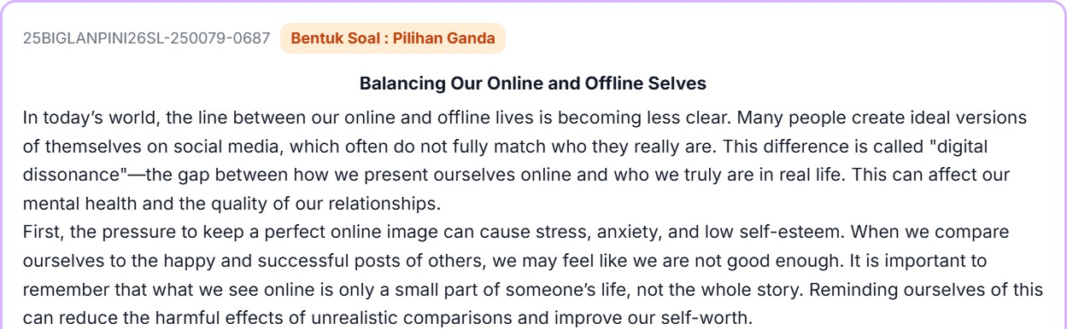
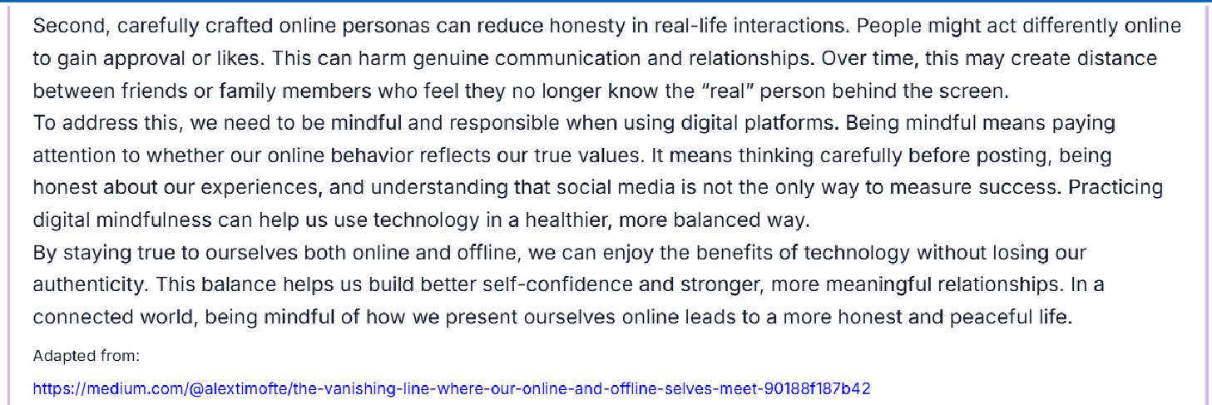
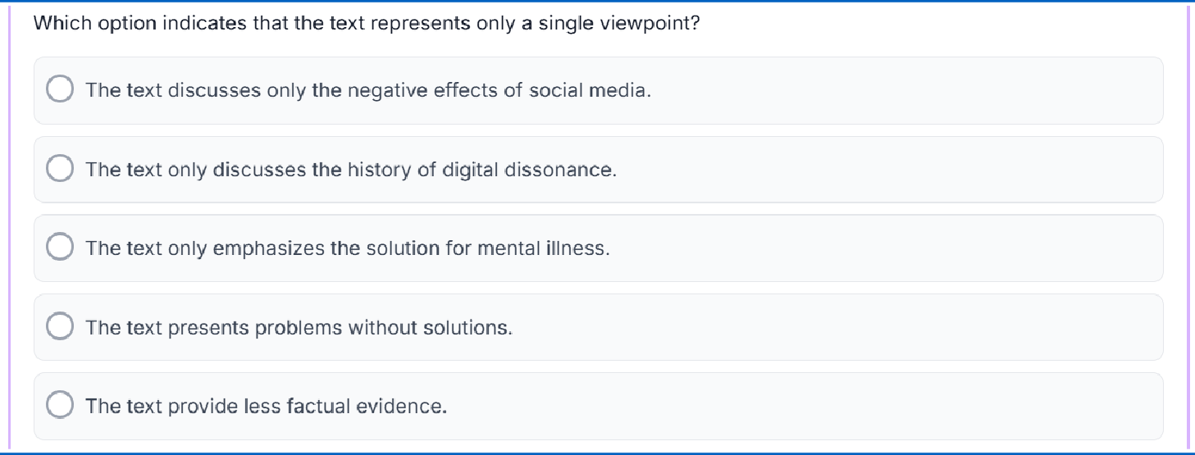
Trik Cepat Menjawab Soal Analisa Sudut Pandang
Pahami makna single view point, Skimming Kata Kunci Efek (stress, anxiety, low self-esteem, harm); positif/negative, cocokkan setiap opsi jawaban.
B❌ Teks fokus pada kondisi masyarakat saat ini (In today's world...), bukan menceritakan sejarah masa lalu.
C❌ Teks fokus pada gaya hidup dan kebiasaan berdigital (digital mindfulness), bukan pengobatan medis/psikologis klinis.
D ❌ Salah besar! Paragraf 3 dan 4 justru sangat jelas menawarkan solusi (contoh: "Practicing digital mindfulness can help...").
E ❌ Memang teks ini kurang angka statistik, namun itu bukan definisi utama dari single viewpoint.
A ✅ Hanya membahas efek negative, berarti single view point
Atau:
Jenis Teks apa? (B. Ing TL hanya ada 2 teks : Discussion dan Exposition)
Karena Teksnya Exposition, maka hanya 1 sudut pandang (single point), Pro/cons, positive/negative, benefits/drawback, advantage/disadvantages.
Cari jawaban yang “Only negative” atau “only positive” effects of social media A ✅

Slide 11
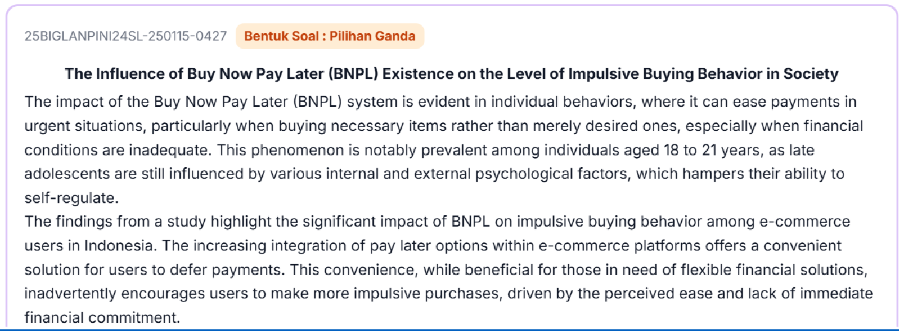
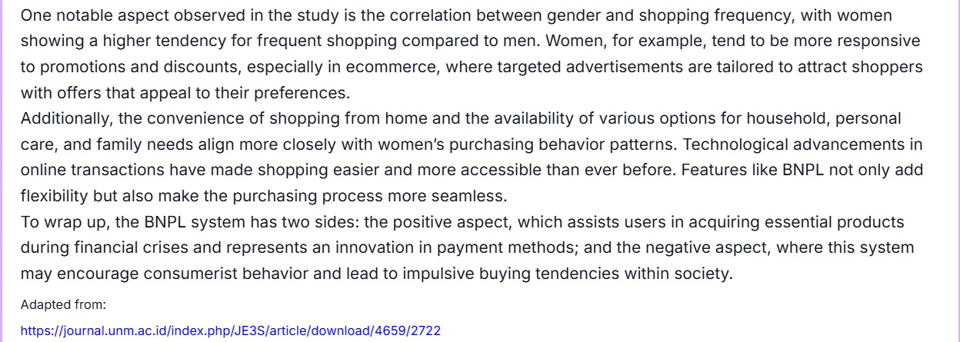
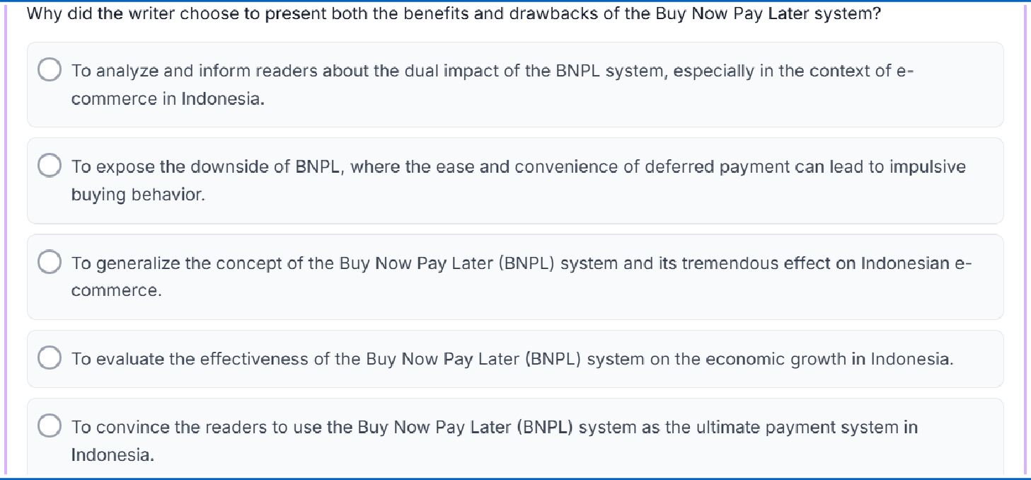
Trik Cepat Menjawab Soal Analisa Sudut Pandang
Jenis Teks apa? (B. Ing TL hanya ada 2 teks : Discussion dan Exposition)
Karena Teksnya Discussion, maka teksnya pasti menyajikan 2 sudut pandang (different points of view, two sides of an issue, balanced perspectives, opposing views, contrasting opinions, pro/cons, positive/negative, benefits/drawback, advantage/disadvantages.
Pilih opsi yang menunjukkan kata-kata kedua sisi/sudut pandang A ✅ (dual impacts)
Mengapa opsi lain salah?
B: Hanya sisi negative downside of BNPL
C: Tidak memuat pernyataan 2 sisi
D: Hanya sisi positive the effectiveness of BNPL
E: Bukan tujuan teks Discussion / tidak menyajikan infomasi dari 2 sudut pandang

Slide 12
Let’s Collaboborate!
Kelompok B. Inggris Wajib
Fokus Tugas:
Membedah paket soal otentik untuk meracik trik/strategi menaklukkan soal
Level 1 & 2.
Jenis Text Descriptive, Recount, Narrative, Procedure, Analytical Exposition
Kelompok B. Inggris TL
Fokus Tugas:
Membedah teks akademis/faktual rumit dan menyusun strategi "jalan pintas" menyelesaikan soal Level 3.
Jenis Text Hortatory Exposition dan Discussion

Slide 13
Presentasi & Micro-Sharing
Langkah Presentasi Tiap Kelompok:
1. Pemaparan Strategi Tampilkan secara singkat teks soal yang dianalisis, lalu bagikan rumusan "trik kilat" yang telah ditemukan.
2. Tanggapan Forum Kelompok lain berhak memberikan tanggapan, validasi, atau mencatat strategi tersebut untuk diadaptasi.
3. Dokumentasi Output Notulen akan merangkum seluruh strategi ini untuk dibagikan ke anggota MGMP.

Slide 14
Thank You

